Slide 1
Voice Assistant On Pc Presented By, Prakhar Srivastava(181500471) Akshat Diwivedi(181500062) Sristi Shukla(181500727) Simran Gupta(181500713)

Slide 2
Contents
Introduction.
History.
Basic Concepts Used.
Working.
Available Applications.
Features.
User Interfaces.
Advantages & Disadvantages.
Virtual Assistant in Future.
Conclusion.

Slide 3
Introduction
To call any technology that makes our lives easier by one name is almost impossible. There are a variety of terms that refer to agents that can perform tasks or services for an individual, and they are almost interchangeable — but not quite. They differ mainly based on how we interact with the technology, the app, or a combination of both. The key here is voice. A voice assistant is a digital assistant that uses voice recognition, speech synthesis, and natural language processing (NLP) to provide a service through a particular application.

Slide 4
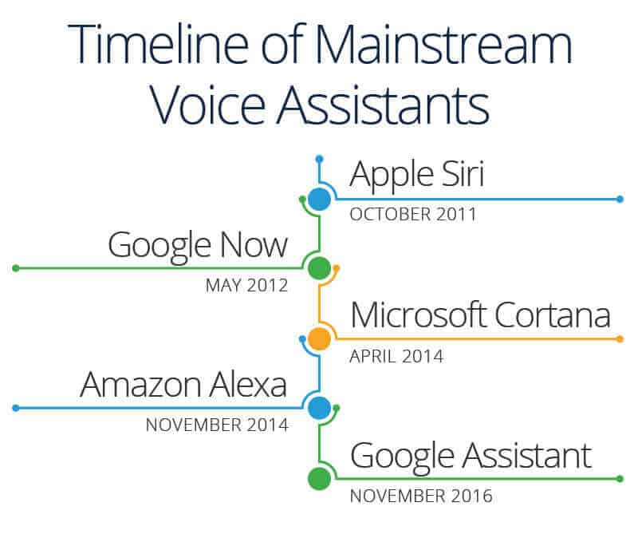
History Voice recognition technology was around long before Apple’s Siri debuted in 2011. At the Seattle World’s Fair in 1962, IBM presented a tool called Shoebox. It was the size of a shoebox and could perform mathematical functions and recognize 16 spoken words as well as digits 0-9. In the 1970s, scientists at Carnegie Mellon University in Pittsburgh, Pennsylvania — with the substantial support of the United States Department of Defense and its Defense Advanced Research Projects Agency (DARPA) — created Harpy. It could recognize 1,011 words, which is about the vocabulary of a three-year-old. Once organizations came up with inventions that could recognize word sequences, companies began to build applications for the technology. The Julie doll from the Worlds of Wonder toy company came out in 1987 and could recognize a child’s voice and respond to it. Throughout the 1990s, companies like IBM, Apple, and others created items that used voice recognition. Apple began building speech recognition features into its Macintosh computers with PlainTalk in 1993. In April 1997, Dragon came out with Dragon NaturallySpeaking, which was the first continuous dictation product. It could understand about 100 words per minute and turn it into text. Medical dictation devices were one of the earliest adopters of voice recognition technology.

Slide 5



Basic Concept Used
The working of Voice Assistant using following principles:
. Natural Language Processing.
.To understand user’s speech input.
. Automatic Speech Recognition.
.To understand command according to user’s input.
. Artificial Intelligence.
.To learn things from users and to store all information
about behaviour and relations of user
. Inter Process Communication.
.To get important information from other users.

Slide 6

Working
Any Voice Assistant basically consist of three layers:
Speech to text.
Text Analysing.
Interpret commands.

Slide 7
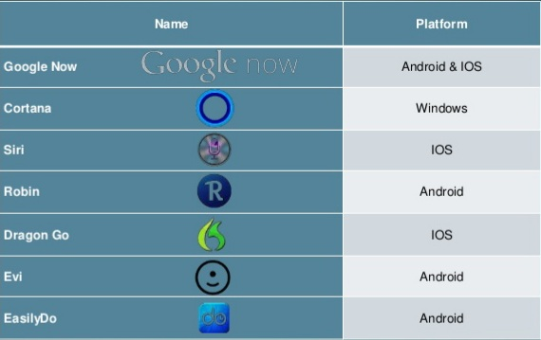
Available Applications

Slide 8
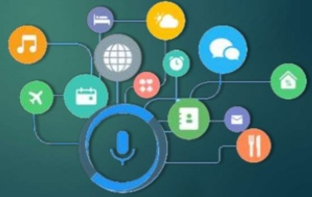
Features
Speaks Naturally.
Communicate with surroundings and other object.
Event based services.
Grows with you.
Get smarter every day.
Will entertain you

Slide 9

Features
Some of the features of Voice Assistant, you may ask him day by day users are shown below:
Make Phone Calls.
Schedule meetings & Appointments.
Get Direction.
Send Messages.
Set Reminders.
Ask Questions .
Play Music & Videos.
Wake me up at 6:30am.

Slide 10
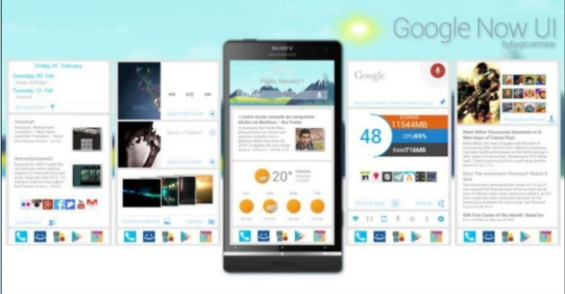
User Interface
Google Now

Slide 11
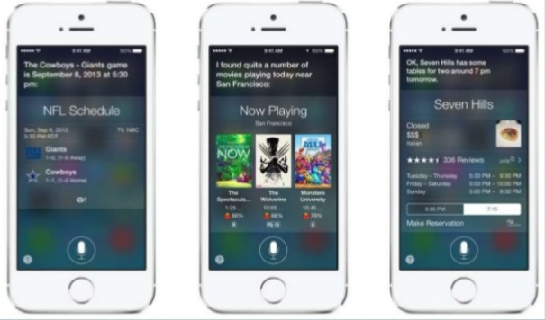
User Interface
Siri

Slide 12
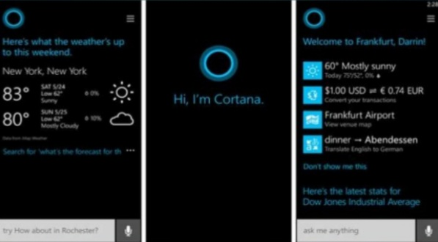
User Interface
Cortana

Slide 13
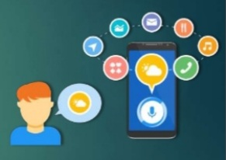
Advantages
These applications make small and smart hand-held devices to combine multiple features.
They allow you to export and import data.
Store various information.
Make to do list.
Recognize voice commands.
Controls various application of device.
Helps to plan your whole day.
Provides service regarding your location.
Reminds you important things on accurate situation or location.

Slide 14
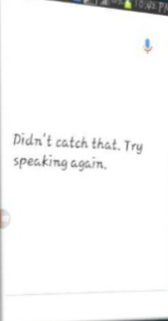
Disadvantages
Listening problem.
Silent mode support.
Navigation languages.
Internet access.

Slide 15
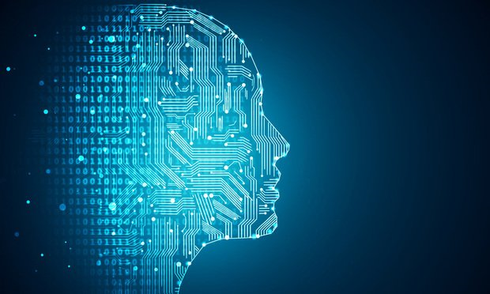
Voice Assistant in Future
Next step will be to strip back the physical hardware as far as possible.
With the intelligence of the VA existing in the cloud, getting pulled in and pushing its way into our lives on multiple devices on our bodies and in our office, homes, and vehicles.
Your VA will be continually prompting you with suggestions and taking instructions, and will known more about you than perhaps you do yourself.
We can expect this device to be implanted and permanent.

Slide 16
Conclusion
Voice Assistant are very effective way to organize your schedule. Now there are many Smart Personal Assistant applications available in market for various device platforms.
These new Software Applications are performing really well than PDA devices as they provided with all resources of your smartphone.
Voice Assistant are also reliable than Human Personal Assistant because, Voice Assistant are more portable and you can use them anytime. They also have lot of information than any assistant as they are connected with internet.

Slide 17


